Slide 1

AIRPORT FWD DATA ANALYZER
Backcalculation Training Presentation
FWD/HWD data review and pavement layer evaluation
Based on the supplied BAKFAA 3.4 engineering source
Copyright © 2026 Sahil Yadav
Support: skonetechsupport@gmail.com

Slide 2
Presentation Outline
  FAA Airport Pavement R&D Overview
  BAKFAA Introduction
  BAKFAA Main Features
  BAKFAA Modular Interface
    FWD Data
    BAKFAA Inputs
    Backcalculation Analysis
    Load Transfer Efficiency (LTE) Calculation
    Layered Elastic Analysis Program (LEAF)
  Software Demo
    Flexible Pavement Example
    Rigid Pavement Example
    Composite Pavement Example
    LTE Example
  Contact Us

Slide 3
FAA Airport Pavement R&D
Overview

Slide 4

Who We Are
Director of William J. Hughes Technical Center
ANG-E, Shelly Yak
Aviation Research Division
ANG-E2, Mike Paglione
Fire Safety Branch
ANG-E21
David Brill
Human Factors Branch
ANG-E25
Airport Safety R&D Section
ANG-E261, Ryan King, Acting
Navneet Garg
Airport Technology R&D Branch
ANG-E26
James Layton
Qingge Jia
Airport Pavement R&D Section
ANG-E262, Murphy Flynn, Acting
Ryan Rutter
Software and Systems Branch
ANG-E27
Wilfredo Villafane
Richard Ji
Pavement Consultant Support – ARA
Materials Lab O&M – ARA
Facilities O&M - GDIT
Matthew Brynick
Structures and Propulsion Branch
ANG-E28

Slide 5
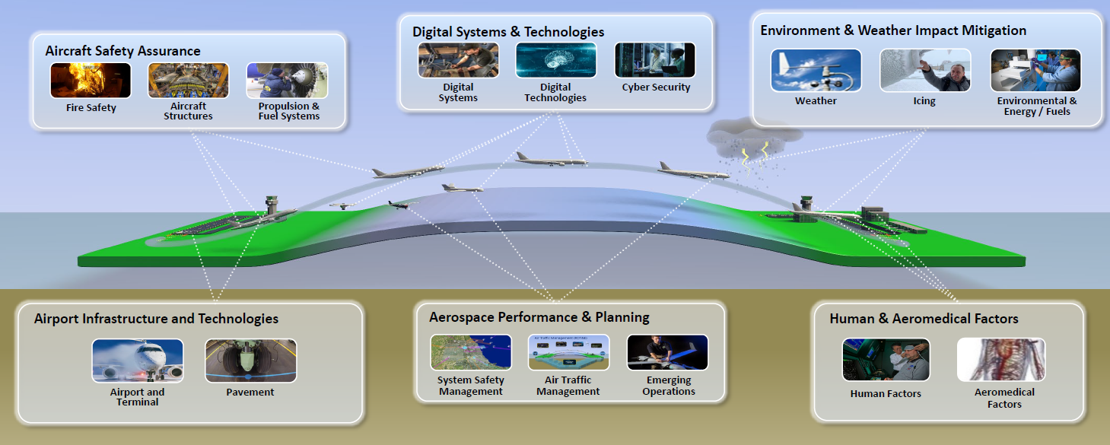
What We Do
Aviation Research Division Mission
  Develop scientific solutions to current and future air transportation challenges by conducting applied research and development in collaboration with industry, academia, and government.

Slide 6
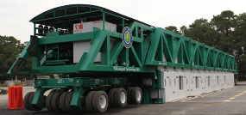

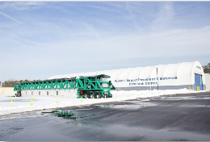
ANG-E262 Airport Pavement R&D
Research Conducted at the FAA William J. Hughes Technical Center, Atlantic City International Airport, NJ, USA.
  ANG-E262 Airport Pavement R&D Section
Sponsor: FAA Office of Airport Safety and Standards, Washington, DC.
  AAS-100 Airport Engineering Division (Michael Meyers)
  AAS-110 Airport Engineering Division (Alberto Cruz, Harold Honey, Jeffrey Crislip)
  AAS-120 Airport Data and Airspace
  AAS-200 Airports Emerging Entrants Division
Provide Support for Development of FAA Pavement Standards
  Advisory Circulars
  Engineering Briefs

Slide 7
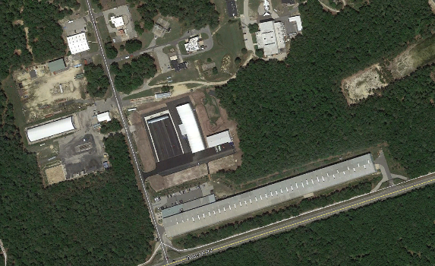
Airport Pavement R&D Section Facility Layout
NAPMRC
Safety
Technology
Future
Asphalt Pavement Lab
Office Space
Soil Processing
Materials Laboratory
NAPTF

Slide 8
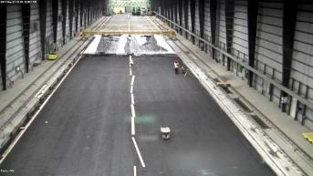

National Airport Pavement Test Facility (NAPTF)
NAPTF Facts:
FAA / Boeing (CRDA) Partnership at $21M
Opened April 1999
Fully Enclosed Facility
Accelerated Traffic Testing
900 ft. x 65 ft. of Test Pavement Surface
Full-scale Pavement Structures and Landing Gear Loads
NAPTV Facts:
  Fully Automated & Programmed Wander Patterns
  Up to 5-dual wheel configuration
  Roughly 1.3 million lbs.
  Up to 75,000 lbs. per wheel

Slide 9
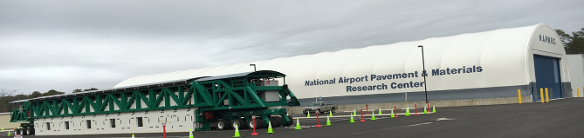
National Airport Pavement Materials Research Center (NAPMRC)
Heavy Vehicle Simulator – (HVS-A) Facts:
  Temperature Control Capability up to 150°F
  Wheel Load Capacity 10,000 to 100,000 lbs.
  Single Wheel – radial aircraft tire size 52×21.0R22
  Dual Wheel (B737-800)
  Fully Automated & Programmed Wander Patterns up to 6 ft.
  Test Speeds 0.17 to 5 mph
NAPMRC Facts:
Dedication Ceremony August 2015
Indoor and Outdoor Testing Capability
Accelerated Traffic Testing
Outdoor: 150ft. × 300ft. & Indoor: 72ft. × 300ft.
Accelerated resurfacing
Notes:
4 outside lanes and 2 inside lanes

Slide 10

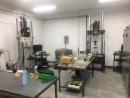
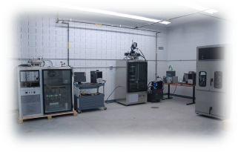
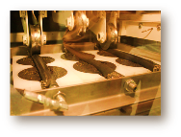


FAA NextGen Pavement Materials Lab
2010: Laboratory Opened
2013: AASHTO Material Reference Laboratory (AMRL)
2013: Cement and Concrete Reference Laboratory (CCRL)
Full Test Capabilities: Asphalt, Concrete, Aggregate, Soils
Advanced Test Capabilities:
  Asphalt Pavement Analyzer (APA)
  Asphalt and Concrete Flexural Beam Fatigue
  Semi-Circular Beam (SCB)
  Disk-Shaped Compact Tension (DCT)
  High Temperature Indirect Tension (IDT)
  Overlay Tester
Benefits to the NAPTF:
  Quality Control of Testing
  Expedient Testing of Materials During Construction
  Perform Advanced Materials Characterization On-site
  Development of Performance Based Specification
Notes:
Aircraft loading conditions vs majority of labs focus on Highway loading conditions
APA testing 254 psi vs 100 psi
New Test Quip machine for Semi Circular Beam (SCB) testing
New Bench top for fine grain soil modulus.
Asphalt beam fatigue aircraft loading conditions
DCT on overlay-cyclic loading
SMA,WMA, and RAP mix characterization testing

Slide 11
BAKFAA Introduction

Slide 12
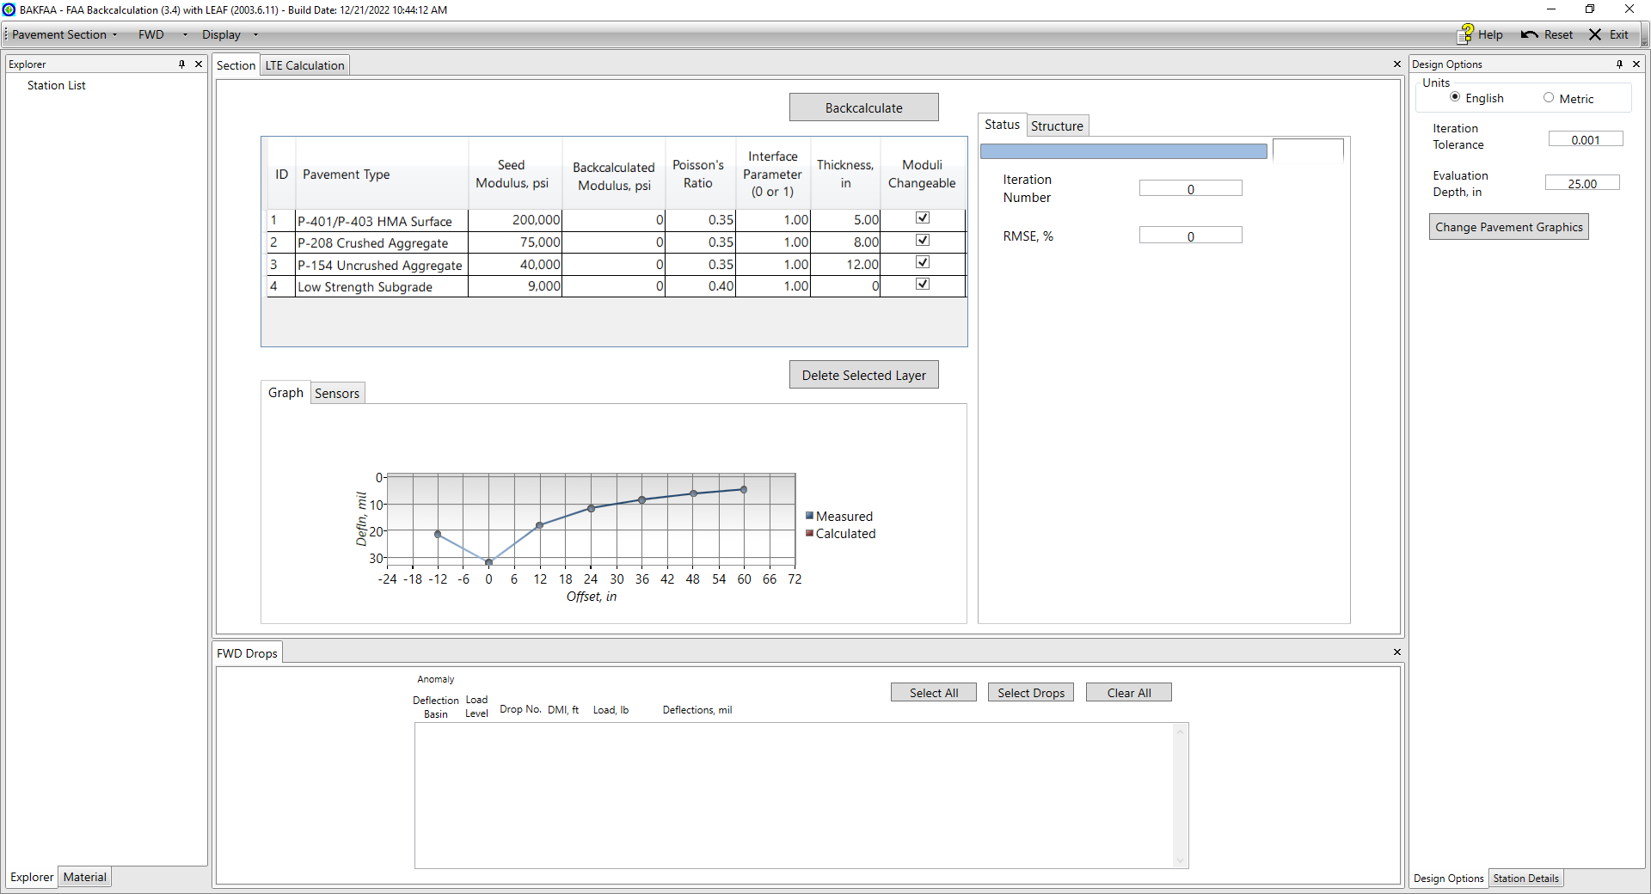
About BAKFAA
Computer program developed by the FAA for backcalculation of pavement layer modulus values using HWD/FWD data.
Publicly available and free to use (source code available).
Descriptions of use included in FAA AC 150/5370-11B ‘Use of Nondestructive Testing in the Evaluation of Airport Pavements’.

Slide 13
BAKFAA Main Features

Slide 14
BAKFAA Main Features
Designed as a Visual Basic .Net application
Ability to switch between English and Metric units
Includes a library of FAA standard pavement material
Ability to import different FWD file formats from leading FWD manufacturers
Converts a proprietary manufacturer’s FWD file into PDDX format file
FWD File Parser: file processing class to read proprietary manufacturer’s file
Ability to identify and flag FWD drops with anomalies
Allows for editing FWD data and deleting FWD test points
Ability to perform backcalculation analysis in single analysis or batch analysis modes
Includes graphs of backcalculated modulus values and measured and calculated deflections
Calculates and displays Load Transfer Efficiency (LTE)
LEAF analysis to calculate pavement responses under aircraft gear or FWD load

Slide 15
BAKFAA Modular Interface

Slide 16
BAKFAA Modular Interface
Graphical user interface was overhauled
Program functions are divided into ‘modules’ that serve a specific purpose
Modules are user-configurable: resize, reposition, or remove as desired
Main program controls relocated and organized in a toolbar
BAKFAA Modules:
  Section
  FWD Drops/Select Load
  Design Options
  LTE Calculation
  (FWD) Explorer
  Material
  Station Details

Slide 17
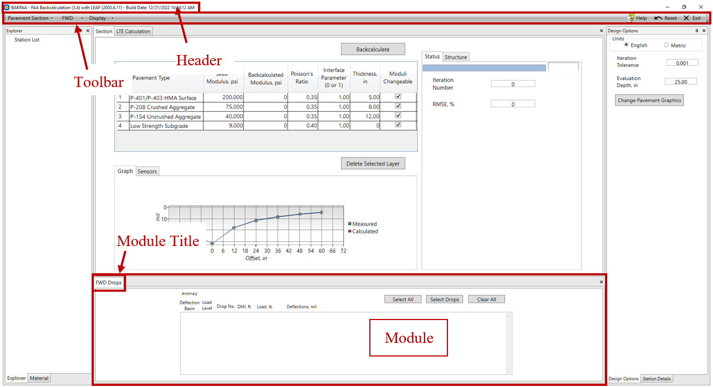
BAKFAA Modular Interface

Slide 18
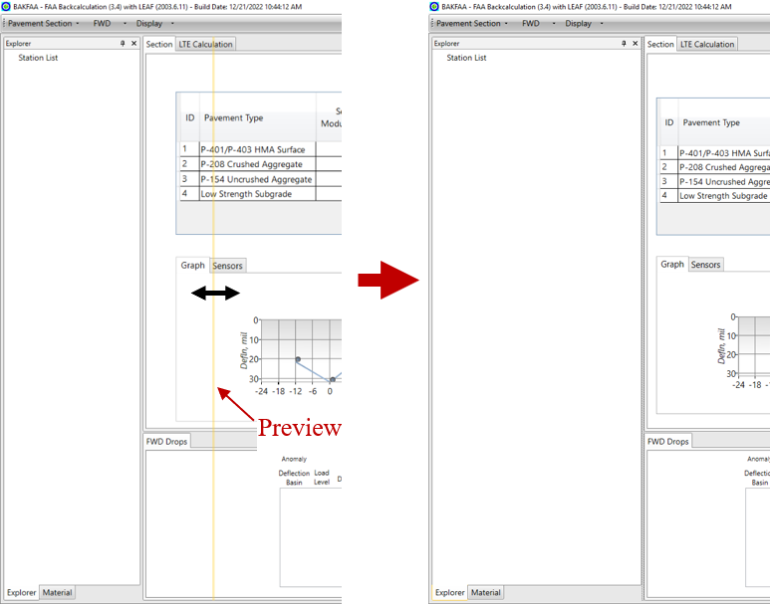
BAKFAA Modular Interface
Module Adjustment
Notes:
resize a module

Slide 19
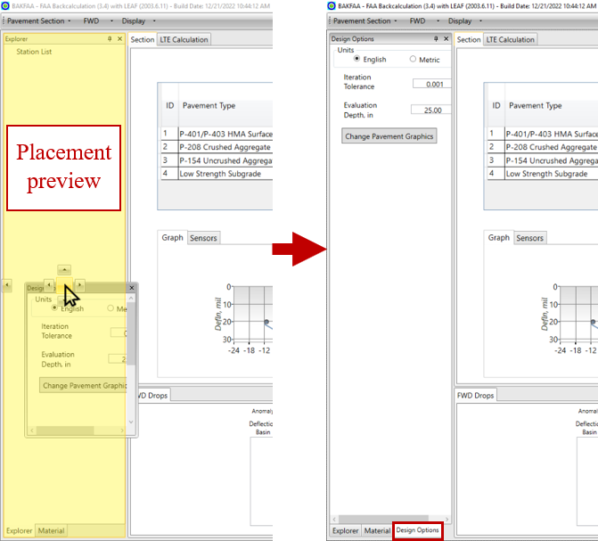
BAKFAA Modular Interface
Module Adjustment
Notes:
move module to new position – grouped tab

Slide 20
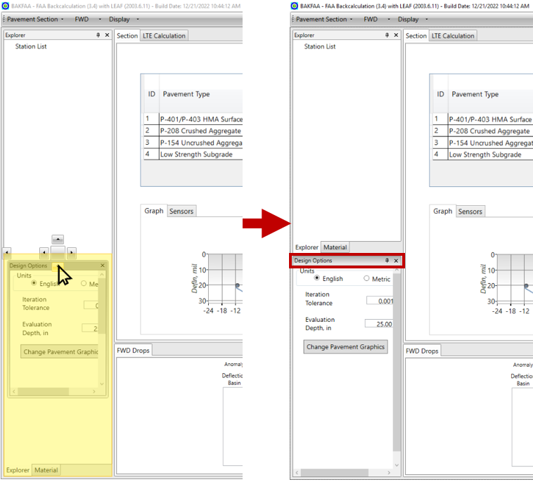
BAKFAA Modular Interface
Module Adjustment
Notes:
move module to new position – ungrouped tab

Slide 21
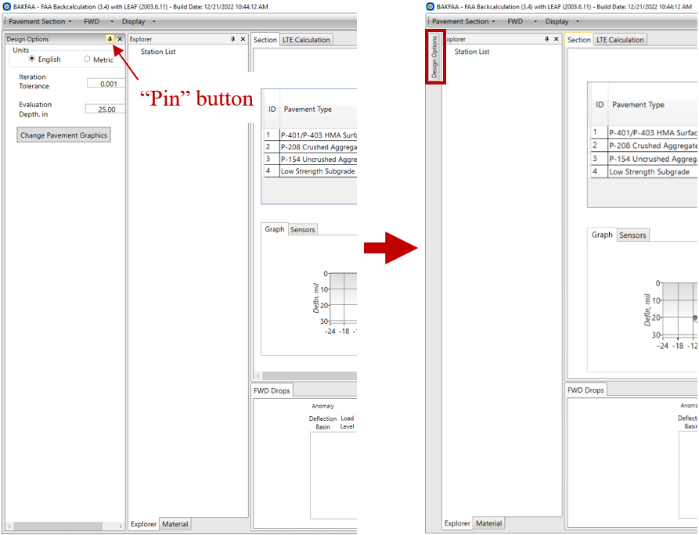
BAKFAA Modular Interface
Module Adjustment
Notes:
change module from a docked tab to collapsible tab

Slide 22
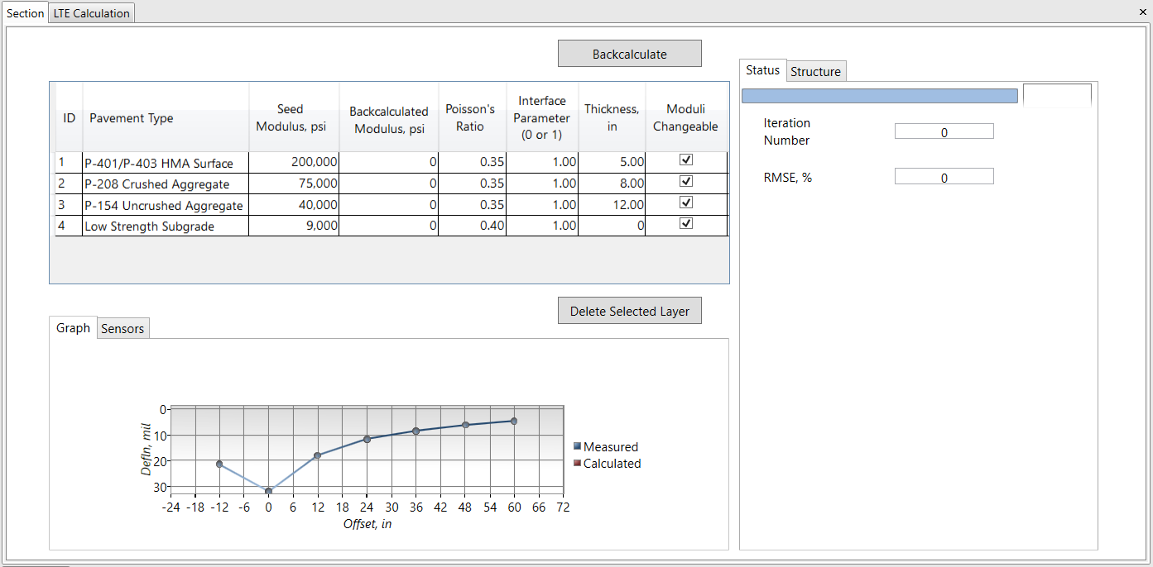
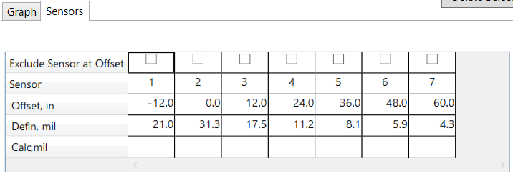
BAKFAA Modular Interface
Section Module
Backcalculation
Status
Pavement Structure
Sensor
Table
Deflection Graph

Slide 23
FWD Data

Slide 24
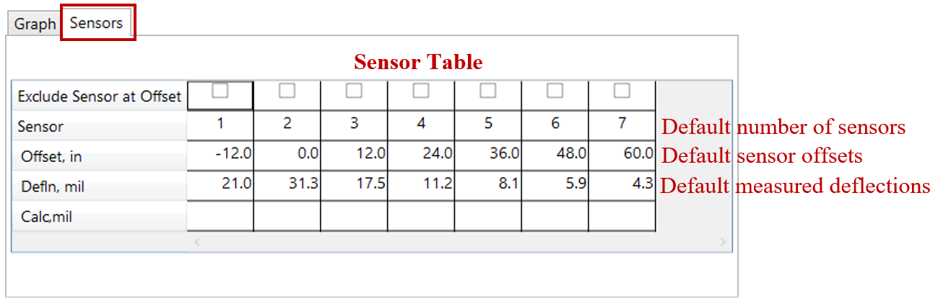
FWD Data
FWD Test Information
Sensor: sensor number
Offset: sensor offset from FWD load plate
Defln: measured FWD sensor deflection

Slide 25
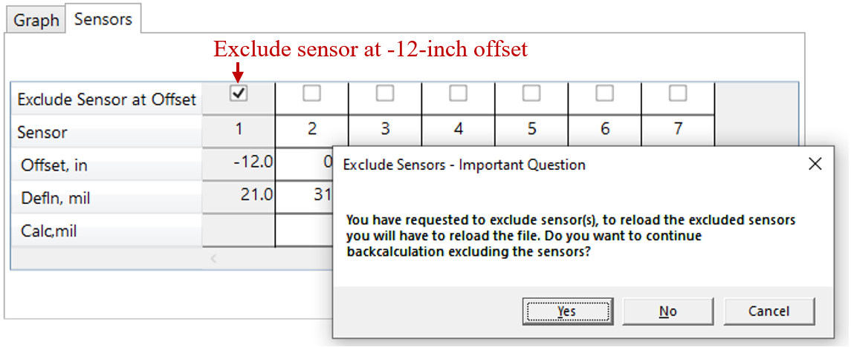
FWD Data
FWD Information updates after Backcalculation Analysis
Exclude Sensor at Offset: allows user to exclude any of the sensors in backcalculation analysis.

Slide 26
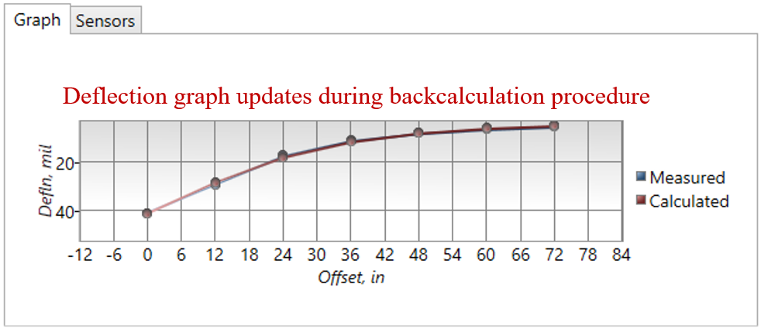
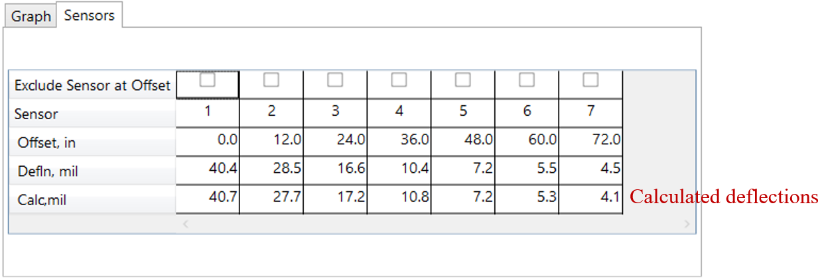
FWD Data
FWD Information updates after Backcalculation Analysis
Deflection Graph: plot of measured and calculated deflections.
Calc: calculated deflections. Will update after the backcalculation is done.

Slide 27
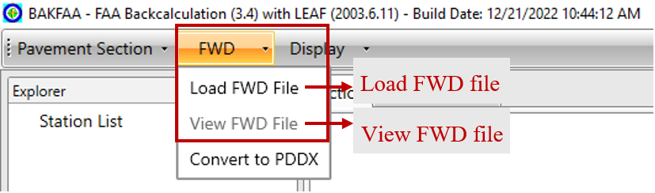
FWD Data
Load/View FWD File
Load FWD File: import FWD file
View FWD File: open FWD file viewer

Slide 28
FWD Data
FWD File Formats
FWD File Formats:
Equipment Manufacturer | Associated Data Format | File Extensions
Dynatest | R80, R32 | .fwd, .hwd
 | F20, F25 | .fwd, .F20, .F25
 | PDDX, XML | .ddx, .xml
KUAB | KUAB | .fwd, .hwd
JILS | M3, M5 | .fwd, .hwd, .dat
PaveTest | PaveTest | .csv
CarlBro | CarlBro | .fwd, .txt
AASHTO | Pavement Deflection Data Exchange | .ddx

Slide 29
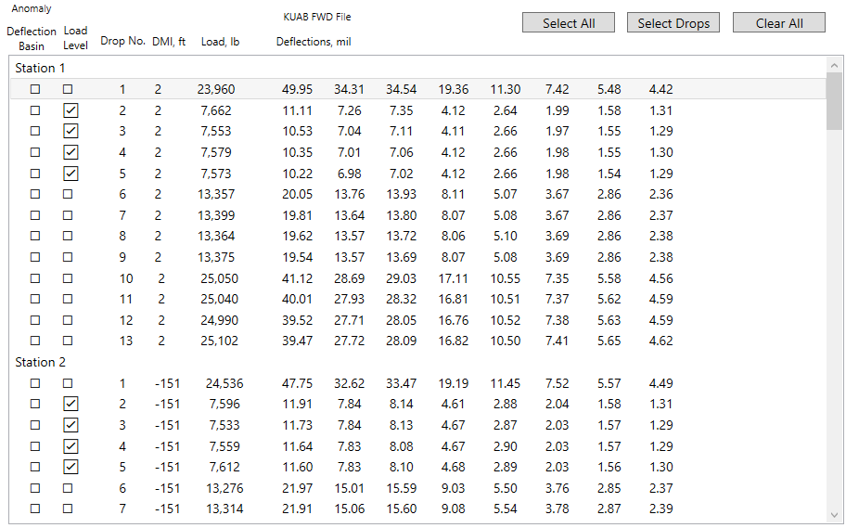
FWD Data
FWD File Information
Anomaly Check: FWD drops are flagged if anomalies are identified.
  Load levels are flagged if FWD plate load is smaller than 9,900 lbs. or larger than 60,000 lbs. (44 kN – 267 kN)
  Deflection basins are flagged if the recorded deflections are one of the following:
    Showing a non-decreasing sequence
    Larger than 100 mils (2540 mc)
    Zero

Slide 30
FWD Data
FWD File Information
Drop No: Number of FWD drops at each test point.
DMI: the station or location of each FWD test point.
Load: the applied FWD load at each drop.
Deflections: measured deflections by each FWD sensor.
Station: operator comments are identified and replaced with a station number.

Slide 31
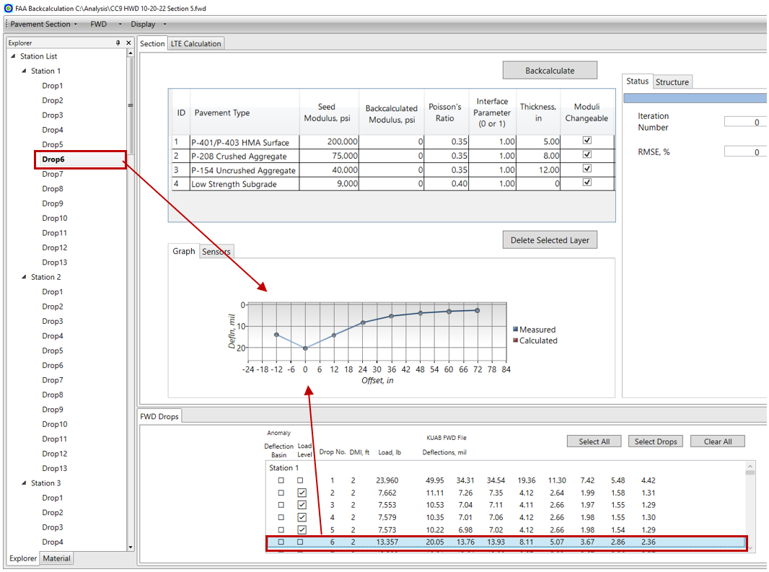
FWD Data
FWD File Information
Deflection information, deflection graph and sensor table will update as the user clicks on an FWD drop.

Slide 32
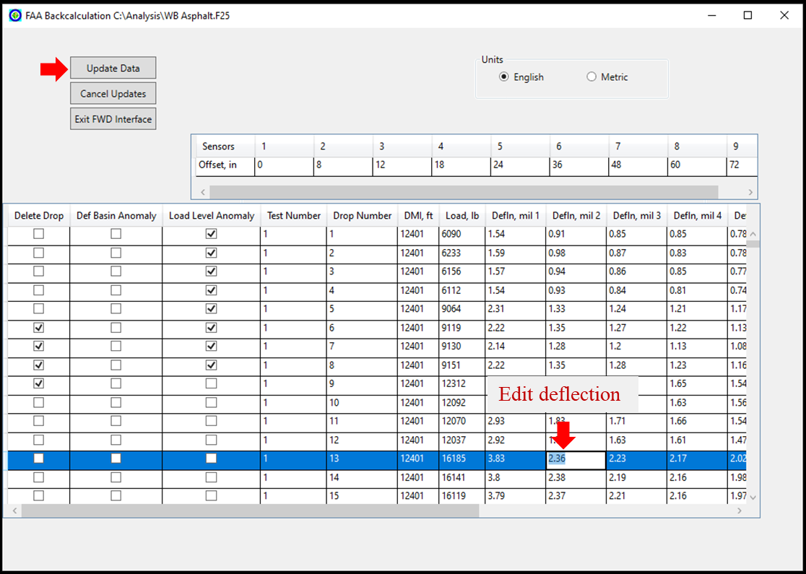
FWD Data
View FWD File
Edit sensor data

Slide 33
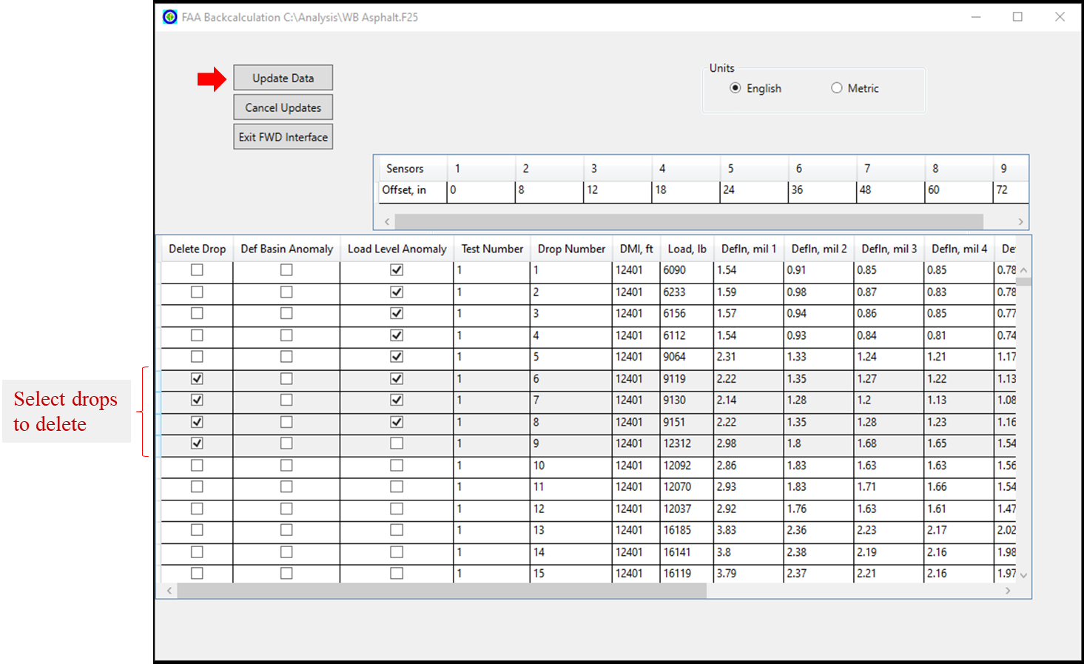
FWD Data
View FWD File
Delete drops

Slide 34
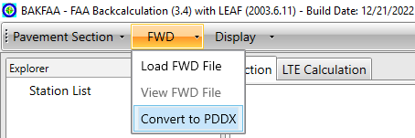
FWD Data
Convert FWD File to PDDX Format
Convert FWD file format supported by BAKFAA to Pavement Deflection Data Exchange (PDDX) format file
PDDX format specification has a modular structure in which data elements of similar characteristics are grouped in individual sections.
The PDDX files can be loaded to BAKFAA

Slide 35
FWD Data
FWD File Parser
A file processing class used to read FWD files.
This class uses the file format specifications from FWD manufacturers and generates a set of properties to retrieve data required for functions in the backcalculation and LEAF analysis.
The advantage of this design is that when a new data format is introduced by a manufacturer, only a file specification needs to be created for the new layout.
BAKFAA will read the specification and parses the file without requiring any reprograming in the source code.

Slide 36
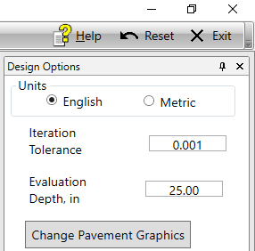
Units
BAKFAA can display values in English or metric units
Radio button under Design Options toggles between the options
Selection updates all FWD and pavement information, and dictates the units used in the output file

Slide 37
Units
Entity | Unit
 | English | Metric
Pavement Layer Thickness | Inch (in.) | Millimeter (mm)
Distance | Feet (ft.) | Meter (m)
FWD Sensor Offset | Inch (in.) | Millimeter (mm)
FWD Sensor Deflection | Mil | Micron (mc)
FWD Plate Radius | Inch (in.) | Millimeter (mm)
FWD Plate Contact Area | Square inch (in²) | Square millimeter (mm²)
FWD Plate Contact Pressure | Pound per square inch (psi) | Megapascal (MPa)
Load | Pound (lbs.) | Kilonewton (kN)
Modulus | Pound per square inch (psi) | Megapascal (MPa)

Slide 38
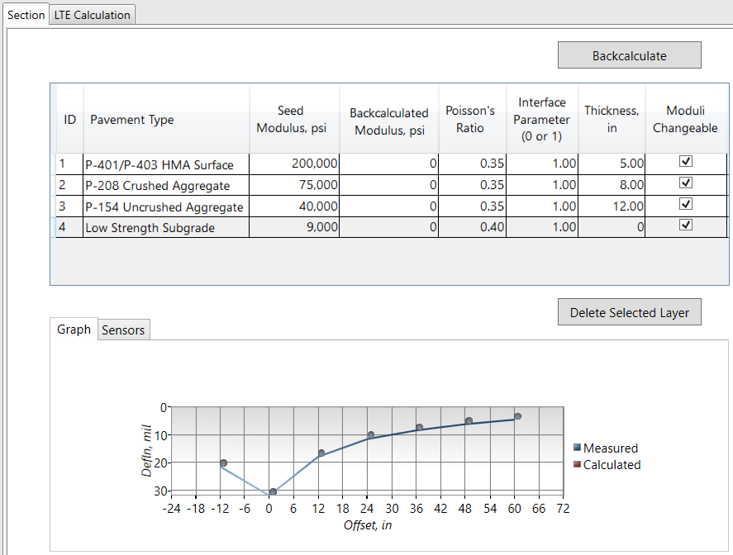
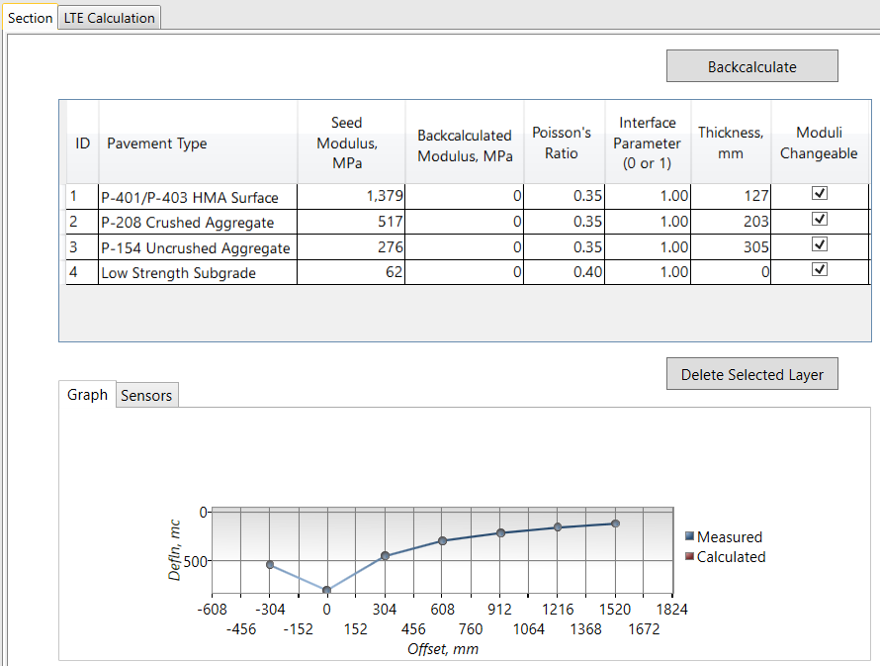
Units
English
Metric

Slide 39
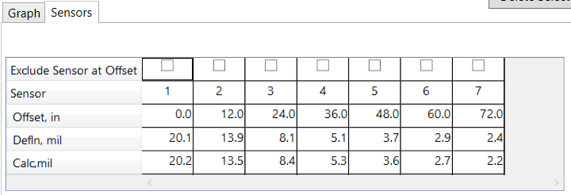
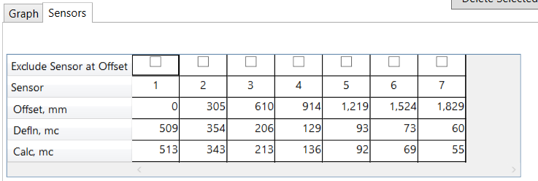
Units
English
Metric

Slide 40
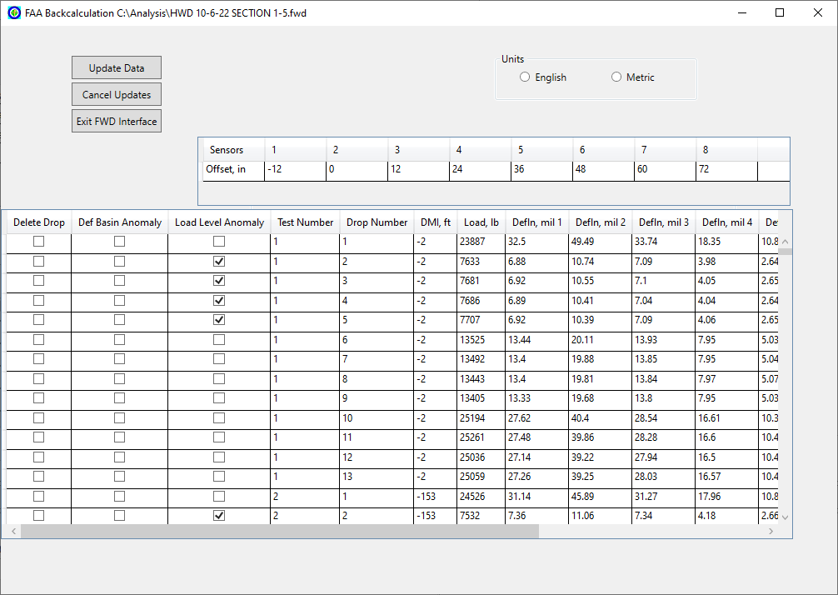
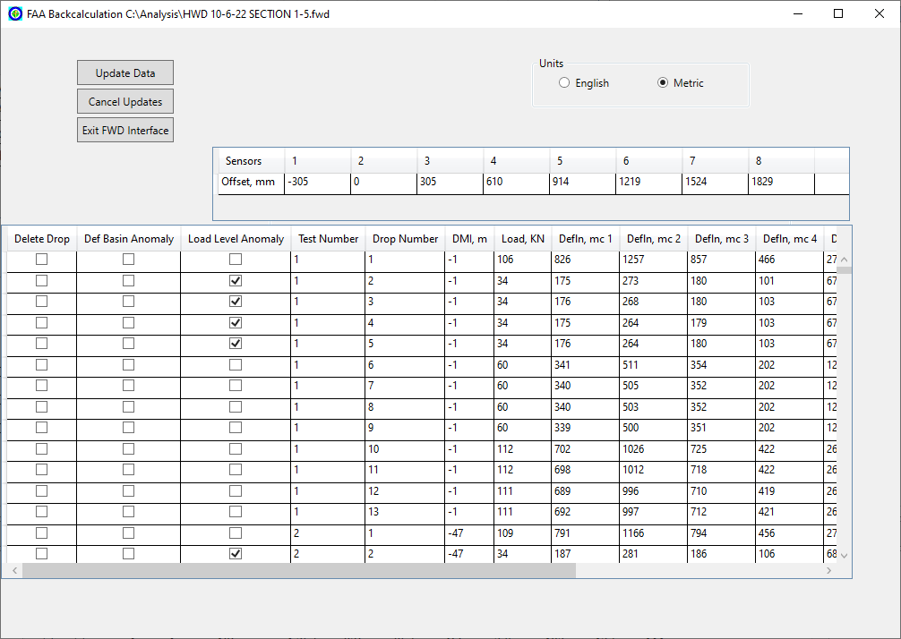
Units
English
Metric

Slide 41
BAKFAA Inputs

Slide 42
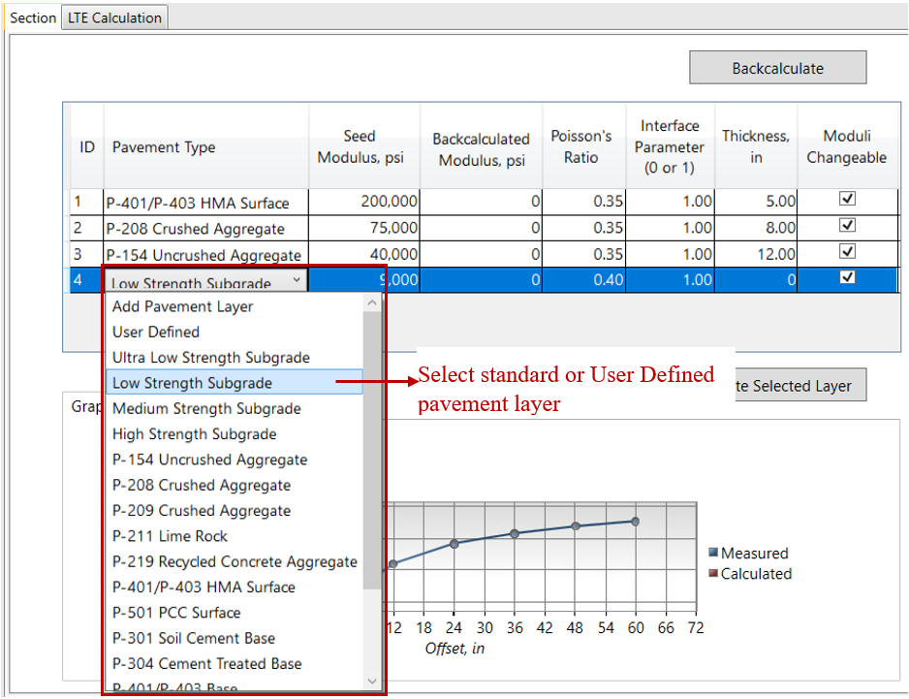
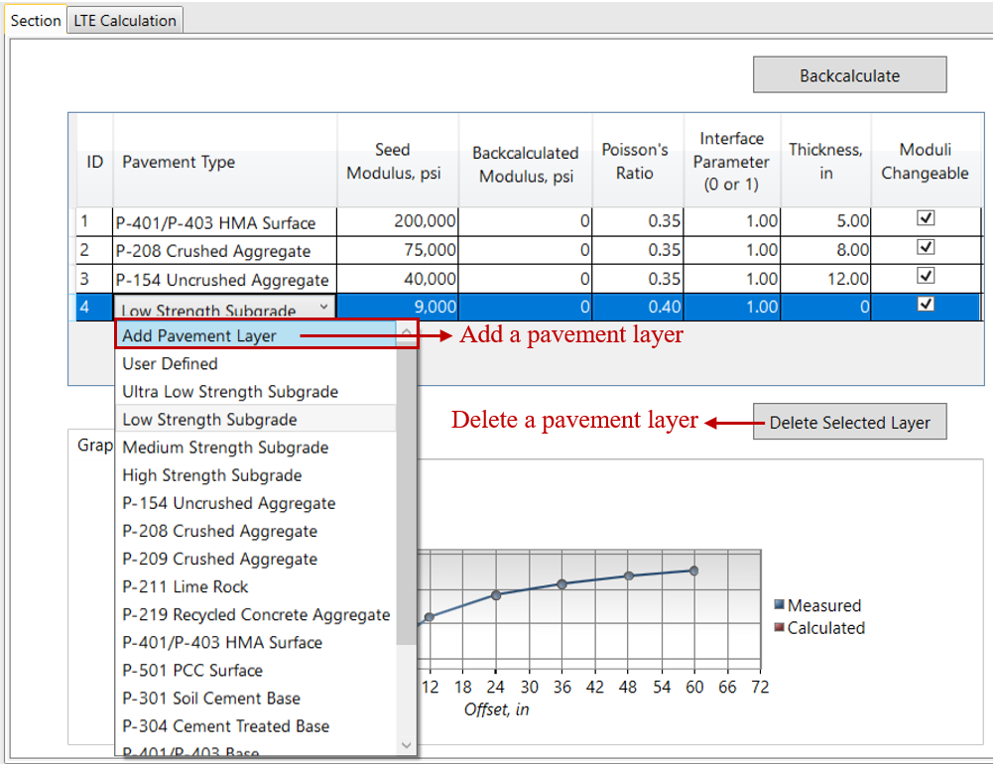
BAKFAA INPUTS
Pavement Layer Properties
Pavement Layer Type:
  Minimum 3 layers and maximum 6 layers
  Select layer type from drop down menu.
  Library of standard FAA materials (AC 150/5370-10)
  Four subgrade types with different strengths
  “User Defined” layer type
  Add or remove a layer from any location in the structure.
  Last layer is a semi-infinite layer

Slide 43
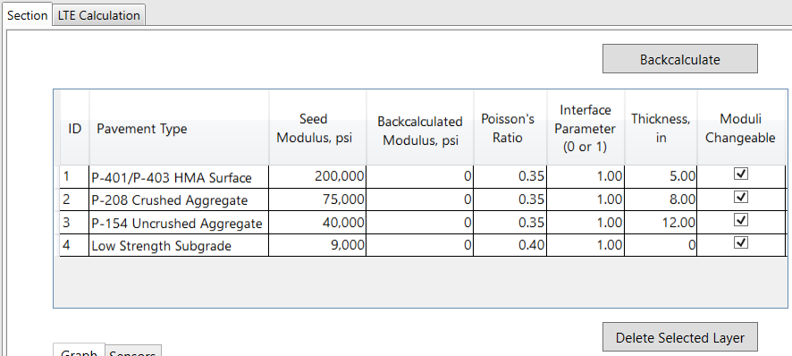
BAKFAA INPUTS
Pavement Layer Properties
Seed Modulus:
  Initial modulus value used in backcalculation iterative procedure
  BAKFAA has default seed modulus values for FAA standard materials
  Default seed modulus values are editable, but BAKFAA will automatically change the pavement type to “User Defined”

Slide 44
BAKFAA INPUTS
Pavement Layer Properties
Poisson’s Ratio:
  BAKFAA has default Poisson’s ratio values for FAA standard materials
  Numerical value between 0.0 to 0.5
Interface Parameter:
  Accepts values of 0 or 1
  0 indicates no bond
  1 indicates fully bonded layers

Slide 45
BAKFAA INPUTS
Pavement Layer Properties
Thickness:
  BAKFAA requires a non-zero thickness for each pavement layer
  The thickness of the last layer in a pavement structure must be zero to represent a semi-infinite layer
Moduli Changeable:
  Determines whether the layer modulus will change in the backcalculation analysis
  Checkbox toggled off indicates the layer modulus will remain fixed in the backcalculation analysis

Slide 46
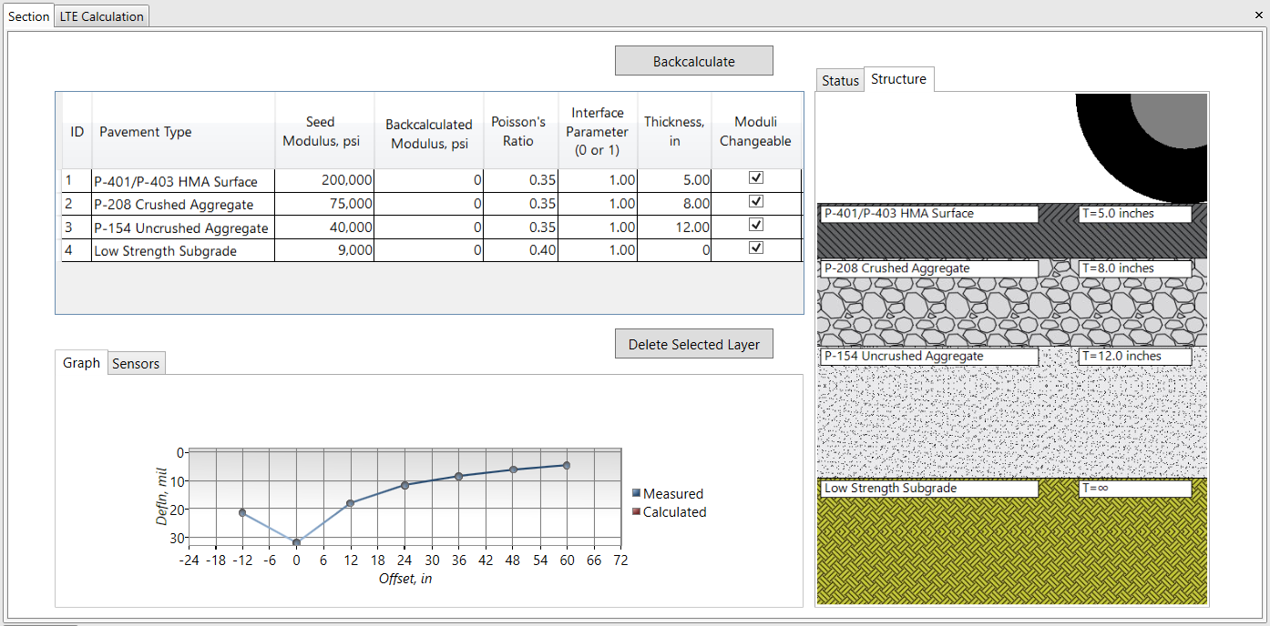
BAKFAA INPUTS
Pavement Layer Structure

Slide 47

BAKFAA INPUTS
Backcalculation Input
Iteration Tolerance:
  Dimensionless parameter that controls the stoppage criteria in the iterative process of backcalculation analysis
  At the end of each iteration
  BAKFAA stops backcalculation when the rtol is less than the user defined Iteration Tolerance
  Typical range is 0.001-0.1. Iterate through this range to achieve desired accuracy.
MD_{i} and CD_{i} : measured and calculated deflections at sensor i
N : the number of FWD sensors
(Err)_{j} and (Err)_{j+1} are the errors at two consecutive iterations j and j+1

Slide 48
Backcalculation Analysis

Slide 49
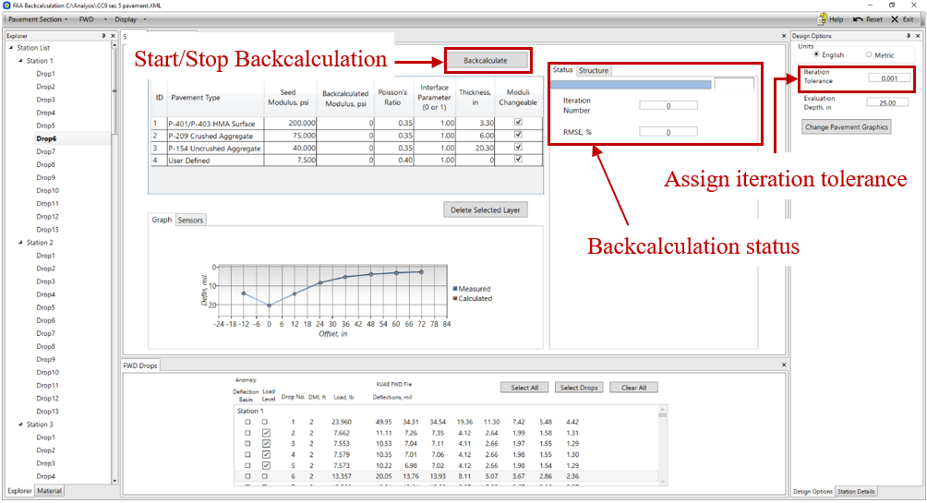
Backcalculation
Analysis Mode
Single Analysis Mode: when a single FWD drop is selected. Results will be shown in the program.
Batch Analysis Mode: when more than one drop is selected. Results will be saved in .csv file.

Slide 50
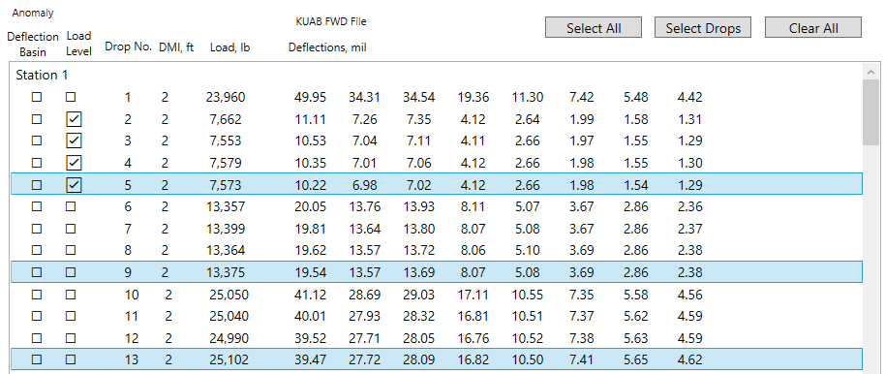
Backcalculation
Select FWD File
Select individual drops
Click on FWD drops to select

Slide 51
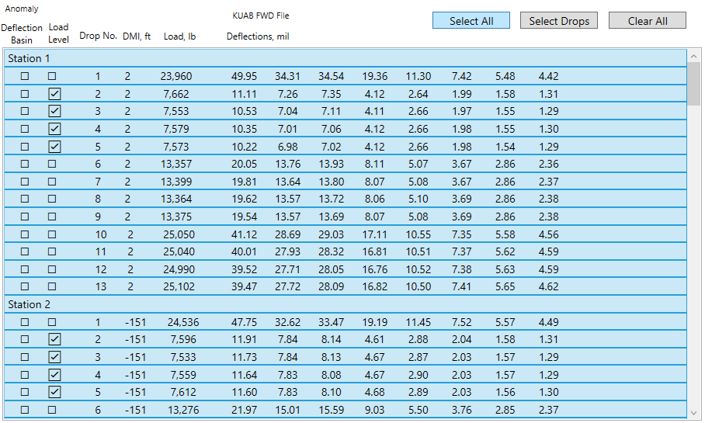
Backcalculation
Select FWD File
Select All button

Slide 52
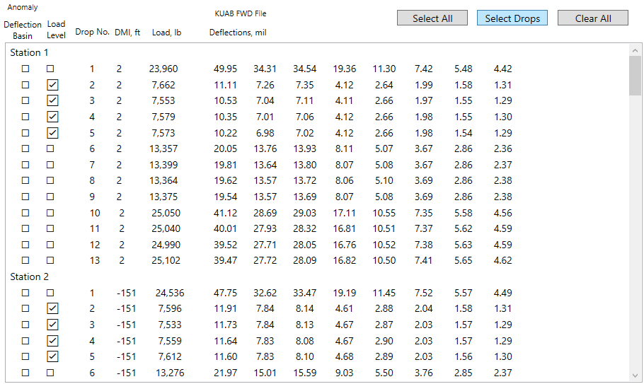
Backcalculation
Select FWD File
Select Drops button

Slide 53
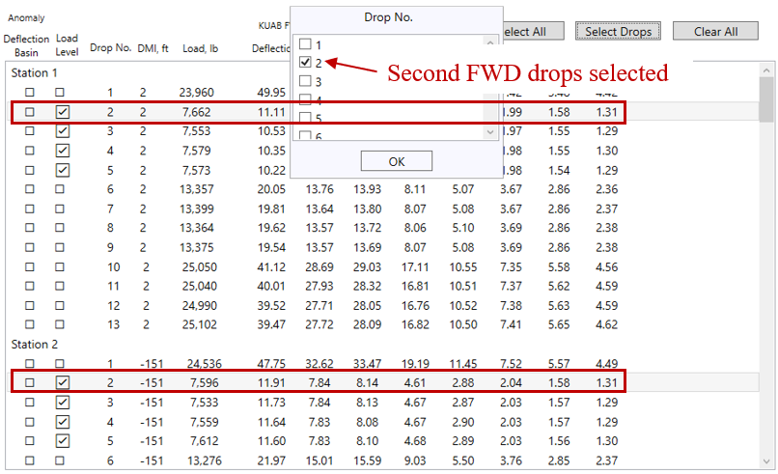
Backcalculation
Select FWD File
Select Drops button
  Selection menu

Slide 54
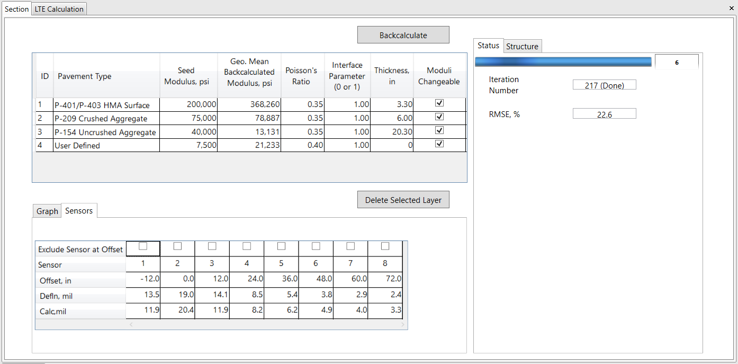
Backcalculation
Analysis Output
Backcalculated Moduli:
  In batch mode: geometric mean (“Geo. Mean”)
Calculated Deflections:
  In batch mode: displayed only for the last drop selected
Iteration Number:
  In batch mode: displayed only for the last drop selected
Geometric mean of backcalculated moduli
Iteration Number
Calculated Deflections

Slide 55

Backcalculation
Analysis Output
Root Mean Square Error (RMSE): between measured and calculated deflections
where:
$$d_{i}^{c}$$ : Calculated deflection for i^{th} sensor
$$d_{i}^{m}$$ : Measured deflection for i^{th} sensor
N: Number of sensors

Slide 56
Backcalculation
Analysis Output
.CSV Output File content:
  Pavement structure (pavement type, seed modulus, Poisson’s ratio, interface parameter, thickness, and moduli changeable)
  FWD (DMI, drop no., load, and operator comments or remarks)
  Iteration tolerance
  Backcalculated modulus
  RMSE
  Number of iterations completed
  LTE values based on the user selection
  Measured deflections for each selected FWD drop
  Calculated deflections for each selected FWD drop

Slide 57
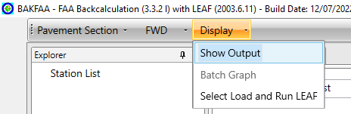
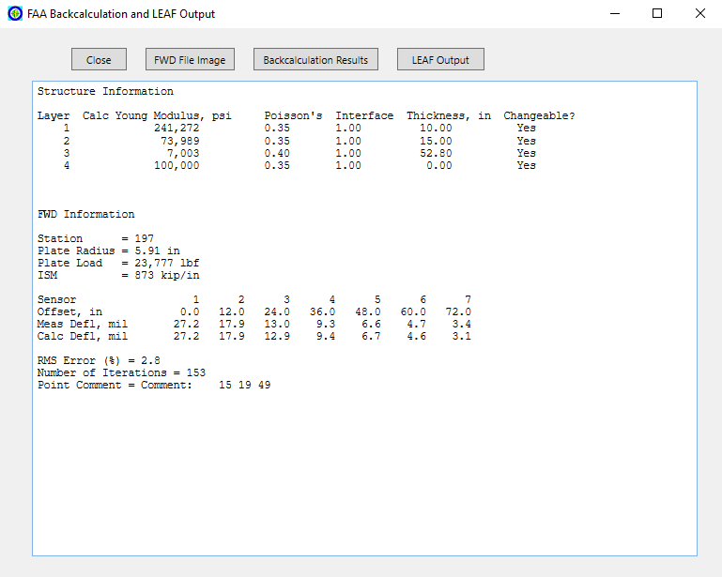
Backcalculation
Show Output
Show Output – Single Analysis Mode
Displays backcalculation results for that drop, including:
  Calculated deflections
  RMSE
  Iteration number
  FWD information
  Impulse Stiffness Modulus (ISM=L/ D₀)
L is the applied FWD load;
D₀ is the deflection under FWD load plate.

Slide 58
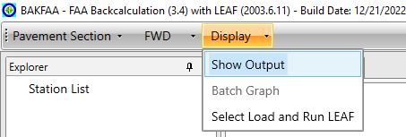
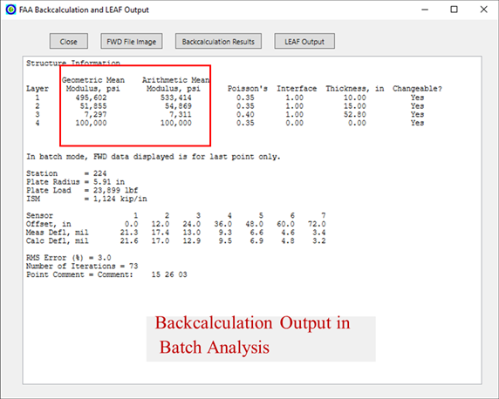

Backcalculation
Show Output
Show Output – Batch Analysis Mode
  Backcalculation outputs, FWD information, and ISM are displayed for the last drop selected
  Arithmetic and geometric means of backcalculated modulus of each layer
n is the number of test points selected for backcalculation;
E₁₁, E₁₂ and E_{1n} are the backcalculated modulus of layer 1 at test points 1, 2 and n.

Slide 59
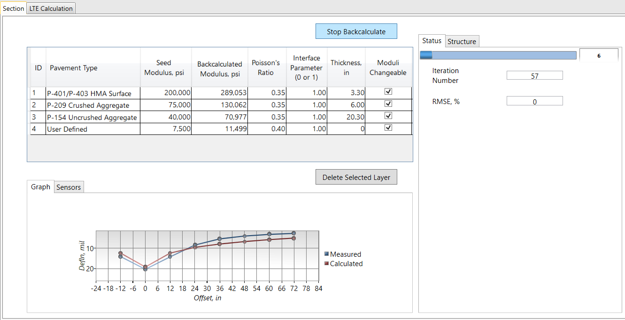
Backcalculation
Stop Backcalculation
Stop Backcalculation
Aborts in-progress backcalculation
Backcalculation results can still be found up to the point of termination:
  In “Show Output” for single mode
  In the .csv file for batch mode

Slide 60
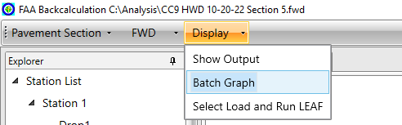

Backcalculation
Batch Graph
Batch Graph
Deflections tab: graphs measured and calculated deflections for two sensors:
  Sensor under the FWD load plate (D₀)
  The outermost sensor (D₇₂)
  “Show Measured” displays measured deflections.
  “Show Calculated” displays backcalculated deflections.
  X-axis is DMI location of selected FWD test points.

Slide 61

Backcalculation
Batch Graph
Batch Graph
Modulus tab: displays backcalculated modulus values in logarithmic scale.
  X-axis is DMI location of selected FWD test points.
  User can toggle off any layer of pavement in the backcalculated modulus graph.

Slide 62
Load Transfer Efficiency (LTE) Calculation

Slide 63

LTE Calculation
Calculate LTE between Two Jointed Concrete Slabs
  Select between case 1, 2, or 3 based on FWD sensor configuration and FWD test layout at slab joints.
  BAKFAA disables case 1 and 2 for FWD tests with no negative offset sensor (-12 in. offset) or when the user excludes the negative offset sensor.
  BAKFAA disables case 3 for FWD tests with a negative offset sensor.

Slide 64
Layered Elastic Analysis Program (LEAF)

Slide 65
Run LEAF
LEAF is built into BAKFAA.
Compute pavement responses (stress, strain, and deflection) under defined load types at different evaluation points within the pavement structure.
LEAF is based on the layered elastic model.
The model is based on the Boussinesq mathematical model which assumes:
  Pavement layers extend infinitely in the horizontal direction.
  Bottom layer extends infinitely downward.
  Materials are not stressed beyond their elastic ranges.

Slide 66

Run LEAF
Inputs Required for LEAF Analysis
Inputs required for LEAF analysis:
  Modulus of elasticity (either seed modulus or backcalculated modulus)
  Poisson’s ratio
  Layer thickness
  Layer interface condition
  Depth of evaluation point
  Continuity in responses across pavement layers depends on their interface condition.
  Depth of evaluation must represent the target layer

Slide 67


Run LEAF
Select Load and Gear Configuration
Select load from library
  Generic gear geometry
  Defined aircraft
  Defined FWD loading configurations
  Library information is in LEAFAircraft.Ext file located in BAKFAA directory (C:\Program Files\FAA\BAKFAA)
  User can modify LEAFAircraft.Ext file or add user-defined landing gear geometry or FWD configuration.
  User can modify coordinates of evaluation points

Slide 68

Run LEAF
Library Example (B-747-400)

Slide 69

Run LEAF
LEAF Outputs
Show Output – LEAF Output
Pavement layer structure table
Aircraft table
Tires data table
Pavement responses at evaluation points including eval point no., layer no. (determined by evaluation depth), X-coord, Y-coord, and Z-depth

Slide 70
Software Demo

Slide 71
Flexible Pavement Example

Slide 72

Click to load FWD file
Load FWD file

Slide 73

Select
Load FWD file

Slide 74

Load FWD file

Slide 75

Assign pavement structure
Material Type | Thickness (in.)
P-401/P-403 hot mix asphalt | 6
P-209 crushed stone base | 12
Subgrade with a CBR of 10
Select layer type from menu

Slide 76

Assign pavement structure
Material Type | Thickness (in.)
P-401/P-403 hot mix asphalt | 6
P-209 crushed stone base | 12
Subgrade with a CBR of 10
Choose subgrade by selecting “User Defined”

Slide 77

Assign pavement structure
Material Type | Thickness (in.)
P-401/P-403 hot mix asphalt | 6
P-209 crushed stone base | 12
Subgrade with a CBR of 10
Add bedrock by selecting “User Defined”

Slide 78

Assign seed modulus
Enter seed values
BAKFAA changes layer type to “User Defined” if user change the default seed values
Assigned seed modulus for asphalt based on test temperature of 60°F
Assign seed modulus for subgrade based on CBR:
$$E=1,500×CBR$$
$$=15,000$$ psi

Slide 79

Assign layer thickness
Material Type | Thickness (in.)
P-401/P-403 hot mix asphalt | 6
P-209 crushed stone base | 12
Subgrade with a CBR of 10
Click to enter thickness

Slide 80

Assign layer thickness
Material Type | Thickness (in.)
P-401/P-403 hot mix asphalt | 6
P-209 crushed stone base | 12
Subgrade with a CBR of 10
Complete all Poisson’s ratios
Complete all thicknesses
Thickness of last layer must be zero

Slide 81

Select FWD drop
Click to select FWD drop

Slide 82

Exclude sensor at negative offset
Sensor tab
Click to exclude sensor at negative offset

Slide 83

Exclude sensor at negative offset
Click Yes to confirm

Slide 84

Fix bedrock modulus value during backcalculation
Toggled off to fix the bedrock modulus in backcalculation
Check that correct drop is selected

Slide 85
Start backcalculation
Click to start backcalculation

Slide 86

Backcalculation results
Backcalculated moduli
RMSE

Slide 87

Click to save the pavement and FWD file

Slide 88

Click Yes to confirm saving pavement section and FWD data

Slide 89

Click to save

Slide 90
Rigid Pavement Example

Slide 91

Load pavement section
Load FWD file
Assign layers and thickness
Assign seed modulus
Material Type | Thickness (in)
P-501 cement concrete pavement | 14
P-156 cement treated subgrade | 12
Subgrade with a CBR of 6

Slide 92

Select FWD drops
Click to select FWD drops

Slide 93

Select FWD drops
Select drop no. 3 and click OK

Slide 94

Select FWD drops
All drop no. 3 selected

Slide 95

Start backcalculation in batch mode
Click to start backcalculation

Slide 96

Start backcalculation in batch mode
Click to save .csv output file

Slide 97

Click to save .csv output file
Start backcalculation in batch mode

Slide 98

Backcalculation results in batch mode
Geometric mean of backcalculated moduli from all test points selected.

Slide 99

Click to view Output
Show Output

Slide 100

Show Output

Slide 101

Click
Batch Graph
Click

Slide 102

Batch Graph
Outlier

Slide 103

Click
Edit FWD File

Slide 104

Edit FWD File
Save changes
Click to delete outlier drops

Slide 105
Composite Pavement Example

Slide 106

Load pavement section
Load FWD file
Assign layers and thickness
Assign seed modulus
Material Type | Thickness (in.)
P-401/P-403 hot mix asphalt | 2.25
P-501 Portland cement concrete | 10
Subgrade with a CBR of 15
Asphalt modulus adjusted for temperature

Slide 107

Adjust pavement structure
Toggle off to fix asphalt modulus during backcalculation

Slide 108

Select FWD drops
Select Drops
Select drop no. 2

Slide 109

Start backcalculation in batch mode
Start backcalculation
Click Ok to save .csv, and choose a file location and name

Slide 110

Backcalculation results in batch mode
Geometric mean of backcalculated moduli from all test points selected.

Slide 111

Batch Graph Modulus
Backcalculation results in batch mode

Slide 112
Load Transfer Efficiency (LTE) Example

Slide 113

Click
Load FWD file

Slide 114

Click
Load FWD file

Slide 115

Select FWD drop
Select drop no. 3 at DMI location of 400 ft.

Slide 116

Select LTE case
Click to select Case 2

Slide 117

Review results
LTE %

Slide 118
Support & Technical Contacts
Product support: skonetechsupport@gmail.com
Repository: github.com/sahilyadav-01/airport-fwd-data-analyzer
Original technical source contacts:
Richard Ji, PhD: Richard.Ji@faa.gov
Matthew T. Brynick, PE: Matthew.T.Brynick@faa.gov
Independent branded distribution; not an official FAA release.

